Slide 1

Synthesis from lab to ton scale
V. Breguet Mercier / T. Chappuis / O. Vorlet
ChemTech | 14.09.2021 |

Slide 2
Overview
Collaboration with Metalor for the development of synthesis from lab to industrial production
Target: synthesis of Pd-Ligand catalysts for the fine chemical market
Select potential patent free catalysts
Select, develop and optimize chemistry at lab scale
Measure thermal safety data and perform risk analysis
Scale-up the synthesis from lab scale (few mL) to industrial scale (0,6m³)
Production
Tech transfer

Slide 3
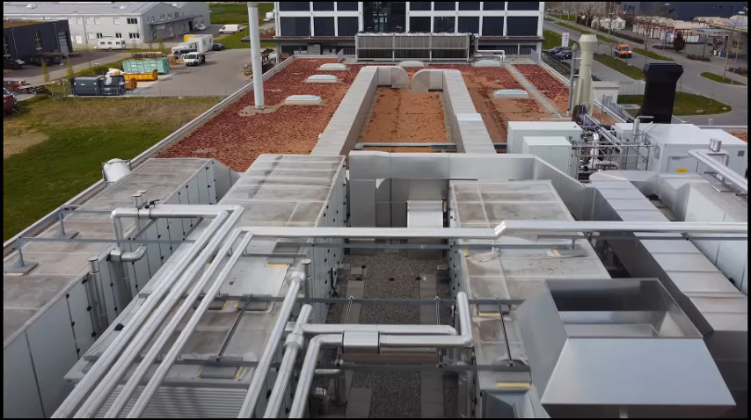

Slide 4
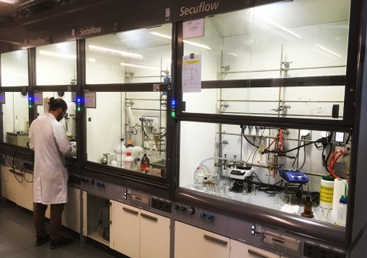
Lab synthesis development
Select molecules
Test and select synthesis routes
Develop synthesis at mL scale
Optimize process to allow further scale up to liter scale

Slide 5
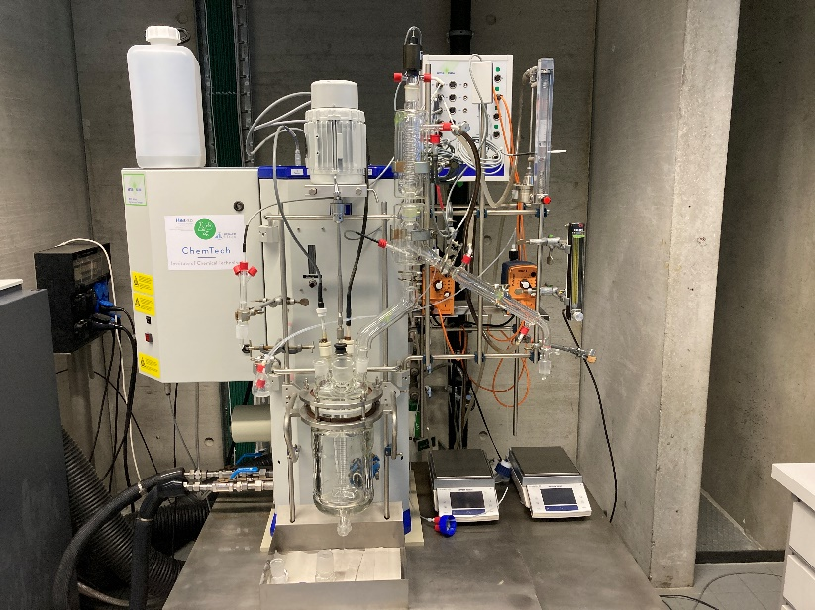
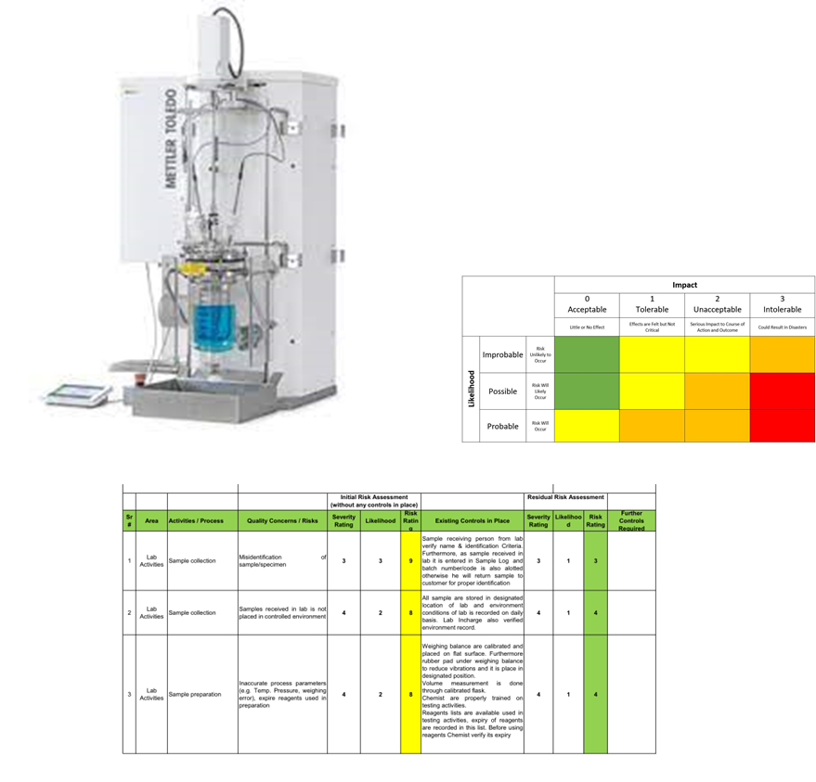
Thermal safety and Risk analysis
Differential calorimetry (DSC) to assess reactant and product stability
Reaction calorimetry (RC1 or Easymax) to evaluate heat of reaction, potential heat accumulation
Risk analysis to ensure process safety at large scale
Notes:
Image thermogramme DSC ?
Photo easy max / RC1 ?
Image de matrice d’analyse de risque ?

Slide 6
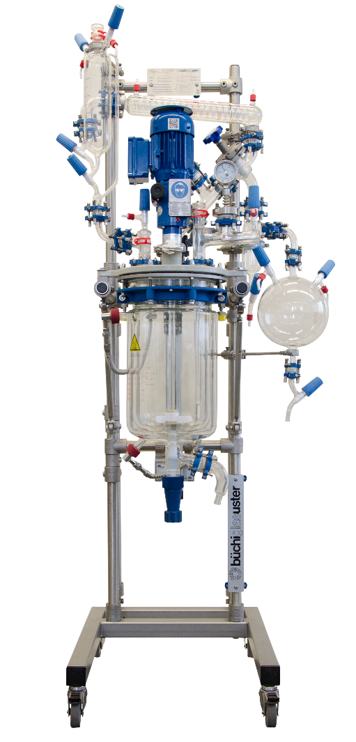
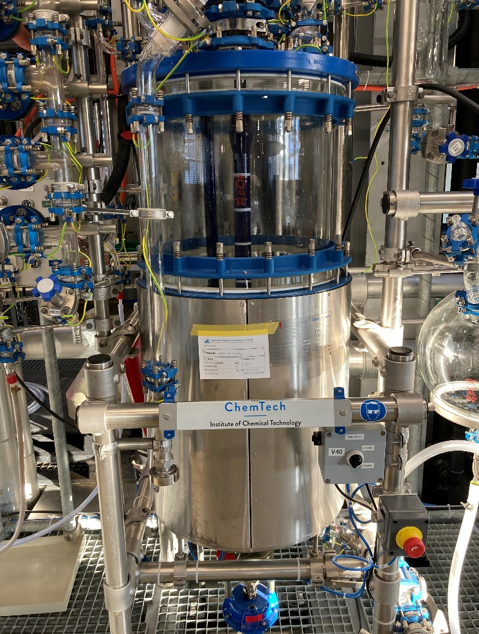
Scale-up
Intermediate scale-up (10 and 100L)
Choice of equipment for large scale synthesis
«Standard Manufactoring Procedure» and batch protocoles
Ensure logistic flux of hazardous and precious chemicals
Notes:
Photos de nos équipements (voir mini film ?)

Slide 7
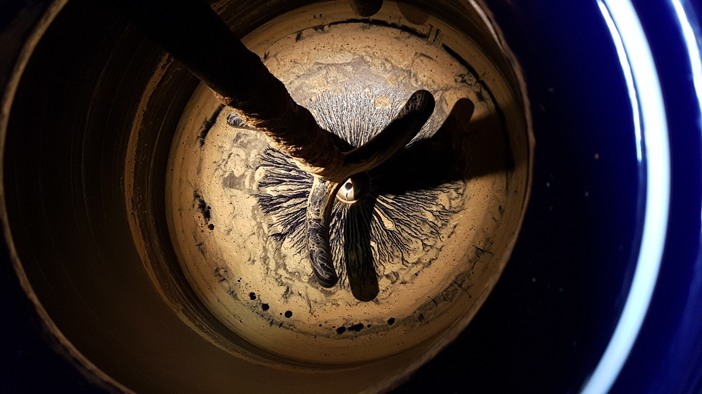
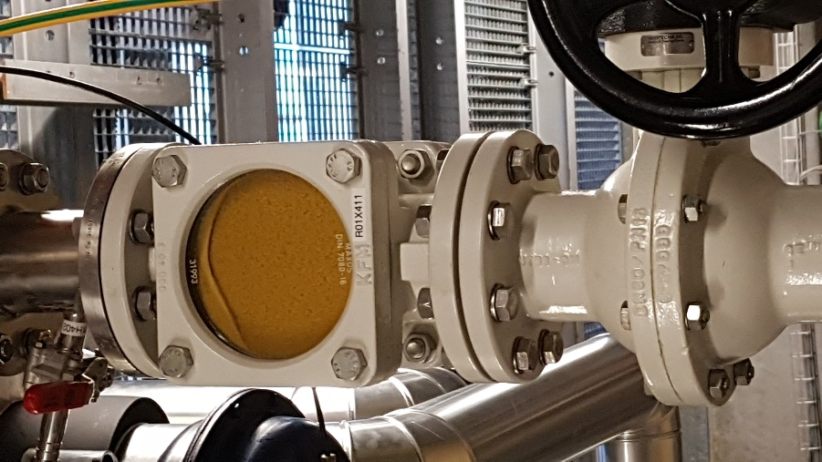
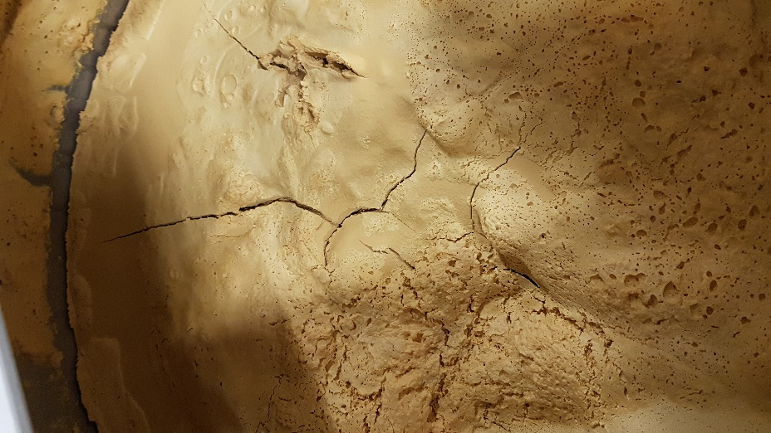
Production
Production at 600 L scale (several batches per week)
Notes:
Photos des «grands équipements», des images des «écrans de contrôles», etc….

Slide 8
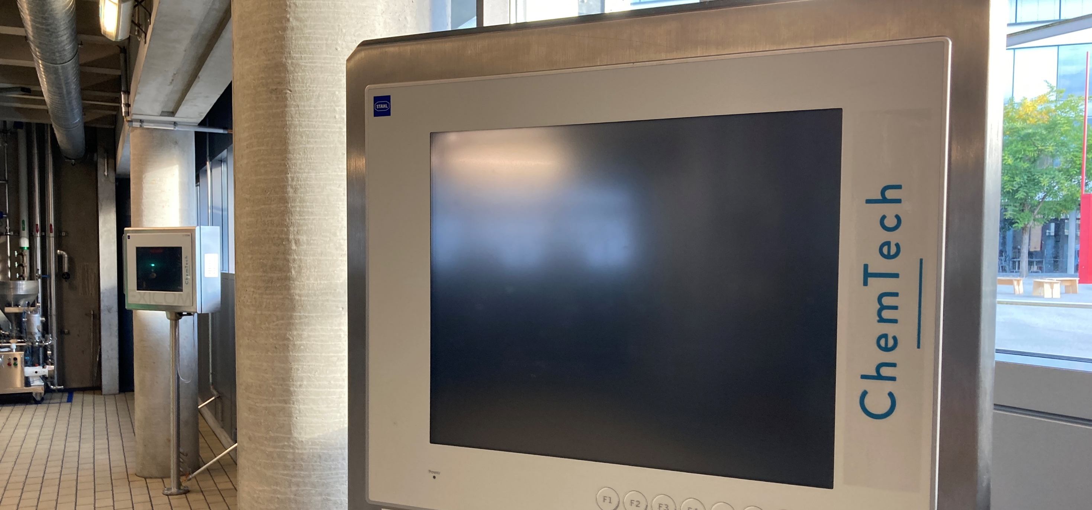
Tech transfer
Help and support the company to build their own facility
Share scientific and technical knowledge
Consulting activities
Notes:
Rajouter que cette collaboration a permis d’engager de nombreux étudiants issus de notre école ?

Slide 9
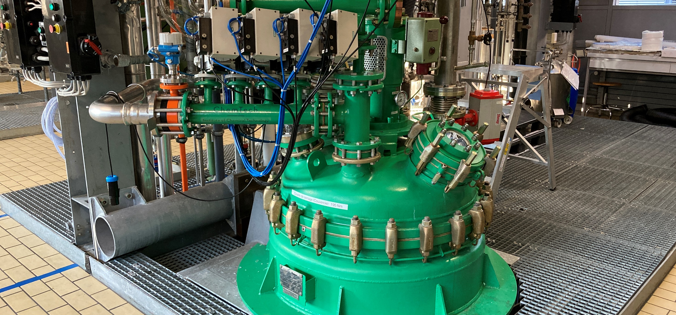
Questions ?
Aknowledgement to Prof J-P Bourgeois & Metalor Technologies

